Slide 1

Financial Development and Economic Growth: Views and Agenda
Author: Ross Levine
Presenter: Weizhao Huang

Slide 2
Introduction
What is finance?
- Finance: a study - of money, banking, credit, investments, asset and liabilities.
- Institutions: banks, stock market, bond markets, etc.
Instruments: share, loan, bond, etc.
Why could finance affect economic growth? (simple way to understand)
- Firms need finance to invest
- More banks enable firms to invest with loans
- Investment leads to economic growth

Slide 3
Financial sector and functional approach
Question: what the financial system does and how it affects-and is affected by-economic growth.
Functional approach: (focus on) ties between growth and the quality of the functions provided by the financial system
Assumption: specific frictions (transaction and information cost), create incentives for the emergence of financial markets

Slide 4
Functions
Primary function--- they facilitate the allocation of resources across space and time, in an uncertain environment
Five basic functions:
Facilitate the trading, hedging, diversifying, and pooling of risk
Monitor managers and exert corporate control
Acquire information about investments and Allocate resources
Mobilize and pool savings
Facilitate the exchange of goods and services
Two channels: capital accumulation and technological innovation

Slide 5
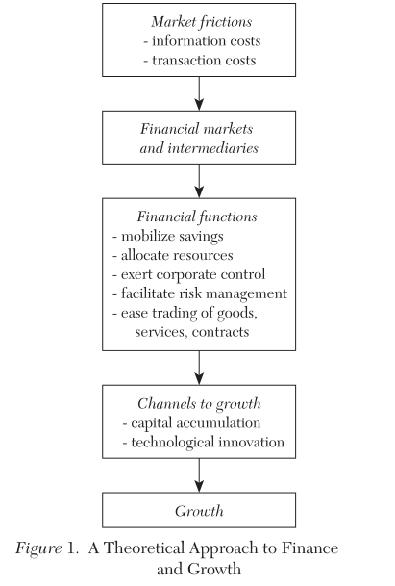
Theoretical Approach

Slide 6
Facilitating risk amelioration
Two types of risk: liquidity risk and idiosyncratic risk
Liquidity risk
- High return projects are less liquid (long-run commitment of capital) than low return projects
- Investors may need liquidity before the return are realized
- Stock markets make illiquid projects more liquid by making them transferable
Banks can help mitigate this risk by holding such illiquid projects or a mixture of liquid and illiquid
Idiosyncratic risk (unsystematic risk)
- Stock markets and banks allow investor to hold portfolio of projects with uncorrelated risk

Slide 7
Acquiring information about investments and allocating resources
It is difficult and costly to evaluate firms, managers, and market conditions
Individual savers may not have the time, capacity or means to collect and process information
High information costs may keep capital from flowing to its highest value use
Financial intermediaries and stock markets may economize on the costs of acquiring and processing information and thereby improve resource allocation (identifying the best production technologies, the firms with the best chances of success)

Slide 8
Monitoring managers and exerting corporate control
Creditors: it is costly for outside investors to verify project returns
One solution: debt contract (Robert Townsend 1979; Douglas Gale 1985)
- it only includes interest rate and monitor only needs to happen in case of default
Second Solution: banks
- they overcome the free riding problem and prevent duplication of monitoring effort
- banks and firms develop long-term relationship, which can further lower information acquistion costs

Slide 9
Monitor managers and exerting corporate control
Shareholders: numerous frictions prevent managers from maximizing shareholder’s value
-information asymmetries between managers and small shareholders
-lack of expertise and incentives from shareholders—free rider problem-too little monitoring
-inefficient protection of minority shareholder or poor enforcement
One solution: concentrated ownership
-the controlling shareholder may also act in his own interest, to detriment of small shareholders
Second solution: liquid stock market
-link managerial compensation to stock prices
-this way, the interests of the managers aligned with the interests of shareholders
-similarly, it is easy to organize takeovers---it is possible to fire managers who underperform

Slide 10
Mobilizing savings
Financial intermediaries overcome costs associated with collecting savings from different individuals
This is particular useful in the case of large number of projects
It also helps investor to hold diversified portfolio

Slide 11
Facilitating exchange of goods
From Adam Smith, economic growth requires higher specialization which needs more transactions
Problem: transaction costs
Financial intermediaries can reduce these costs
- E.g. credit card or bank transfers, Paypal

Slide 12
Evidence: Cross-country studies
The relationship between economic growth and aggregate measures of how well the financial system functions
Goldsmith (1969) uses the value of financial intermediary assets divided by GNP to assess financial development, finds a rough parallelism
Recent researchers (King and Levine) improve the model and use four measures instead of size measure

Slide 13
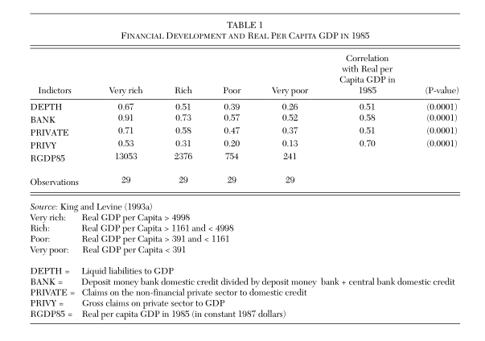
Evidence: Cross-country studies

Slide 14
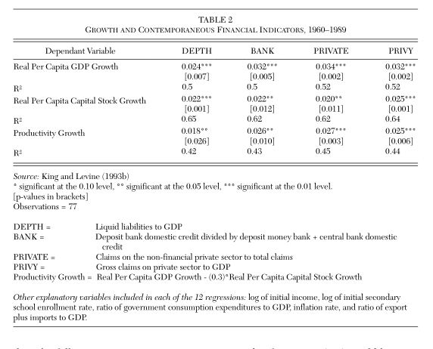
Evidence: Cross-country studies

Slide 15
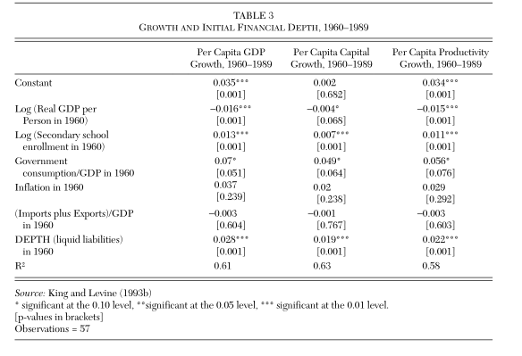
Evidence: Cross-country studies

Slide 16
Country-case studies
A rich complement to cross-country comparison
It starts by describing political system, economic condition and financial structure instead of formal statistical analysis and describe a evolution of financial system
Harber (1991) compares industrial and capital market in Mexico, Brazil and the U.S.
Mckinnon’s seminal book focuses on financial system and economic development in Brazil, Argentina, Korea

Slide 17
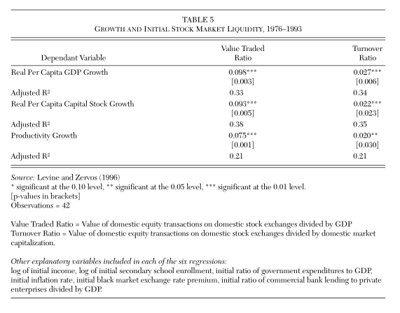
Evidence: Liquidity and risk
Empirical relationship between each liquidity measure and the three growth indicators

Slide 18
Evidence: Information
Empirical studies (Allen Berger 1995, James and Peggy Weir 1990 etc) indicates an important role for financial intermediaries in reducing informational asymmetries between firm insiders and outside investors
Indirectly, countries with financial systems that are effective at relieving barriers will promote faster economic growth through more investment.

Slide 19
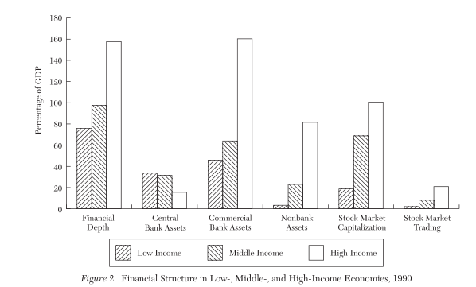
Pattern of financial development
Question: does financial structure change as countries develop and does it differ across countries?

Slide 20
Financial structure and economic growth
Sparse evidence about the relationship between financial and economic growth
Discussion focus on Bank-based versus market-based cases
Germany and the United Kingdom, German and U.S., Japan and the United States
Weaknesses: difficult to quantify the structure of financial system, how well system functions; Hard to build relationship between growth rates and financial sector; The dichotomy is inappropriate ( market base bank base) there is interaction between market and bank; Data limitation

Slide 21
Conclusion
The researches has made important progress, they demonstrate a strong link between the function and economic growth
Much more information about the determinants and implications of financial structure are needed.
Why does financial structure change as countries grow?
Why do countries at similar stages of economic development have different financial system?

Slide 22
Comment
This article does not discuss the relationship between international finance and growth, like international trade in financial services
It does not discuss policy, which require a diverse literatures and studies
Limitations on econometrics method, simultaneous bias, standard of lag variables
Lack of theoretical foundations for initial financial development

